Slide 1
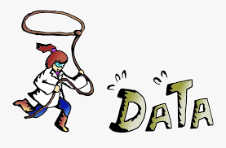
Data Analysis with Python Advanced Data Cleaning
James.Fennell@lit.ie

Slide 2
What is Data Cleaning
Data analysts and scientists spend most of their time cleaning data and pre-processing messy datasets
While this activity is less talked about, it is one of the most performed activities and one of the most important skills for any data professional
Mastering the skill of data cleaning is necessary for any aspiring data scientist

Slide 3
What is Data Cleaning
Data cleaning and pre-processing is the process of identifying, updating, and removing corrupt or incorrect data
Cleaning and pre-processing results in high-quality data for robust and error-free analysis
high quality means accurate, complete, and consistent data
Data cleaning is a set of activities such as handling missing values, removing outliers, feature encoding, scaling, transformation, and splitting

Slide 4
What is Data Cleaning
Data preparation, manipulation, wrangling, and munging are all terms for the same thing
Cleaning up the data in order to get valuable insights
We will start by exploring employee data and then start filtering the data and handling missing values and outliers
After cleaning, we will focus on performing data transformation activities such as encoding, scaling, and splitting
mostly using pandas and scikit-learn in this chapter

Slide 5
What is Data Wrangling
Each data set has its own unique format
Each analysis task will focus on different types/subsets of data and throw up different challenges
When you get a new dataset you must get a feel for the overall structure and any potential issues
check the data loaded correctly and what's going on with the data
Identify inconsistencies in the data or formatting that affect your analysis
you will want to put the data into a format/shape that suits you
This is Data Wrangling! (aka Data Cleansing)

Slide 6
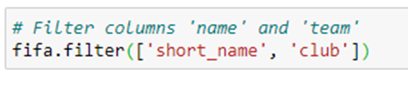
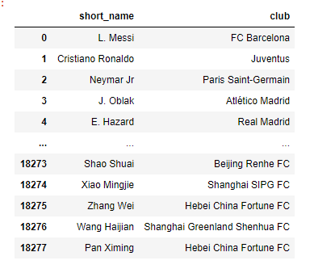
Filtering “Noisy” Data Column-Wise
Big data offer suffers consistency, errors, and missing values
Data filtering is responsible for handling such issues
By filtering dirty, messy, or coarse datasets we boost the accuracy, relevance, completeness, consistency, and quality of the data
Data can be filtered either column-wise or row-wise

Slide 7
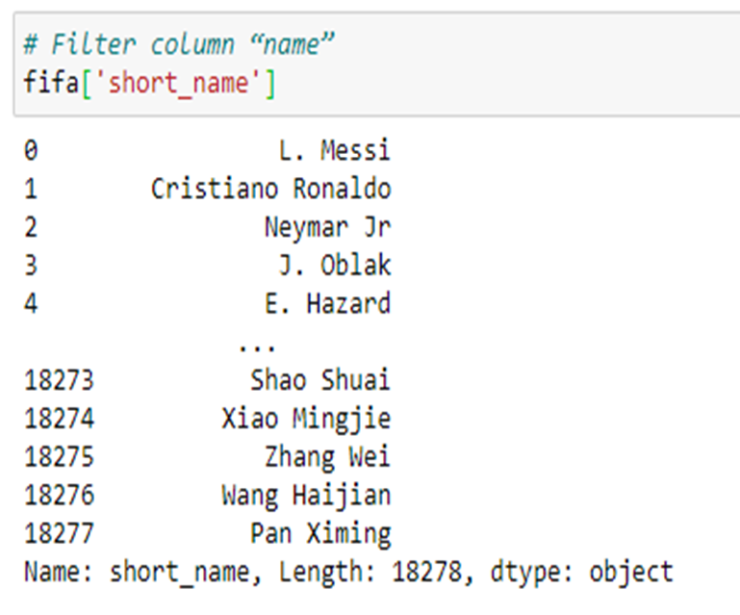
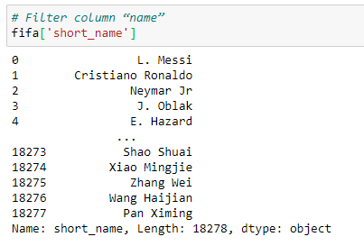
Filtering “Noisy” Data Column-Wise
We can also filter columns using slicing
In slicing, a single column does not need a list
when we filter multiple columns they should be on the list
The output of a single column is a pandas Series
If we want the output as a DataFrame we put the name of the single column into a list
Here we select a single column without passing it into the list
the output is a pandas Series.

Slide 8
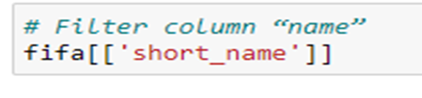
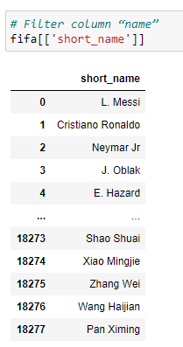
Filtering “Noisy” Data Column-Wise
We can select a single column using a Python list
A single column can be selected using a Python list
The output of this filter is a pandas DataFrame with a single column.

Slide 9
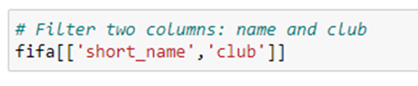
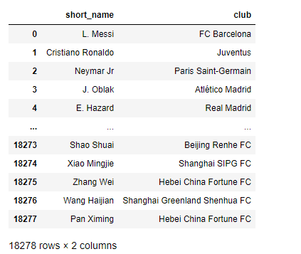
Filtering “Noisy” Data Column-Wise
We can filter multiple columns from the pandas DataFrame
We have filtered the two columns without using the filter() function

Slide 10
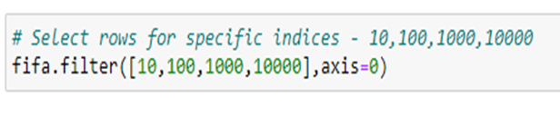
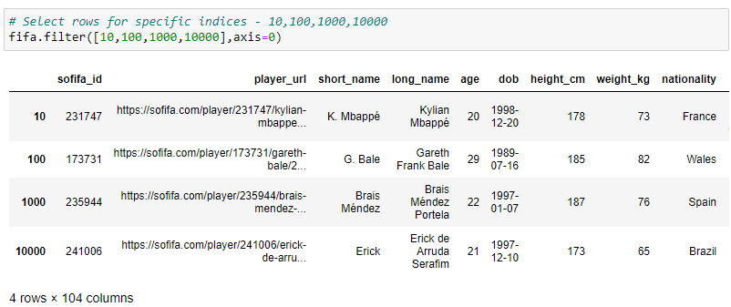
Filtering “Noisy” Data Row-Wise
We can filter data using indices, slices, and conditions
In indices, you have to pass the index of the record
for slicing, we need to pass the slicing range

Slide 11
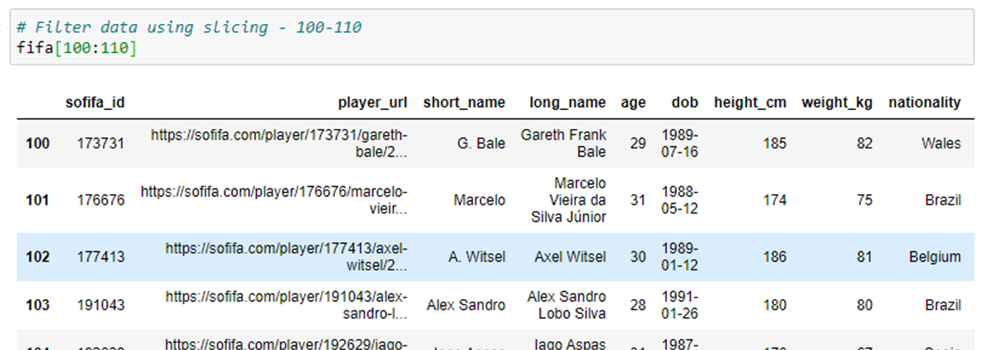
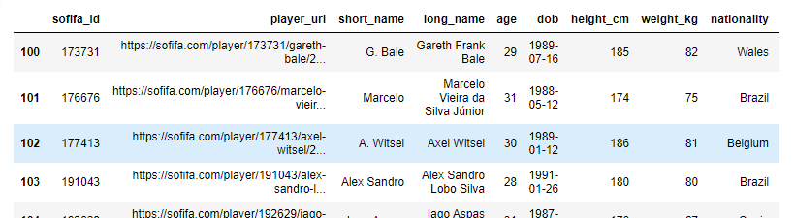
Filtering “Noisy” Data Row-Wise
This is an example of filtering data by slicing

Slide 12
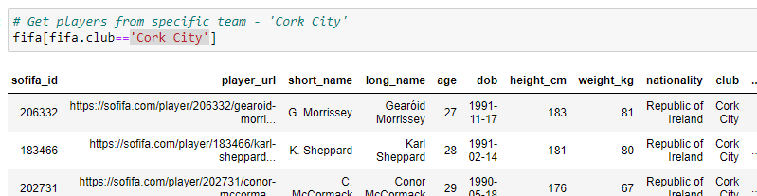
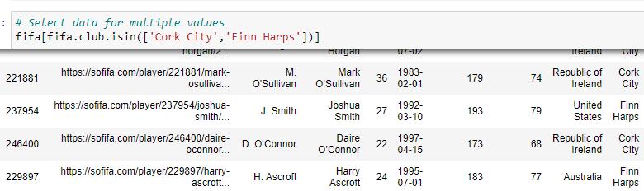
Filtering “Noisy” Data Row-Wise
In condition-based filtration, we have to pass some conditions in:
square brackets, [ ]
or brackets, ( )
For a single value, we use the == (double equal to) condition
For multiple values we use the isin() function and pass the list of values

Slide 13
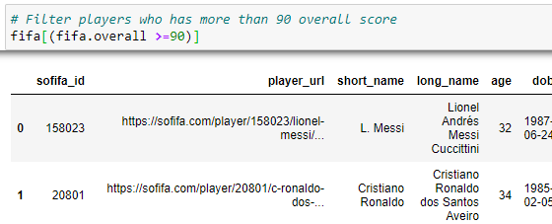
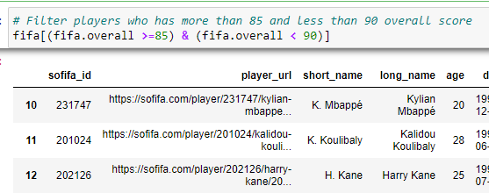
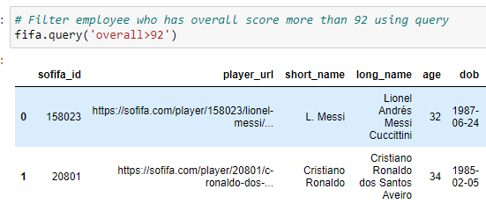
Filtering “Noisy” Data Row-Wise
For continuous variables we can use the >= and <= conditions
We can have single or multiple conditions
The query() method queries the columns using a boolean expression

Slide 14
Handling missing values
Missing values are the values that are absent from the data
Absent values can occur due to human error, privacy concerns, or the value not being filled in by the respondent filling in the survey
This is the most common problem in data science and the first step of data preprocessing

Slide 15
Handling missing values
Missing values can be handled in the following ways:
Drop the missing value records
Fill in the missing value manually
Fill in the missing values using the measures of central tendency
The mean to impute the numeric feature
The median to impute the ordinal feature
The mode to impute the categorical feature
Fill in the most probable value using machine learning models such as regression, decision trees, KNNs

Slide 16
Handling missing values Dropping missing values
Missing values can be dropped using the dropna() function
dropna takes one argument: how
how can take two values: all or any
any drops certain rows that contain NAN or missing values
all drops all the rows contains NAN or missing values

Slide 17
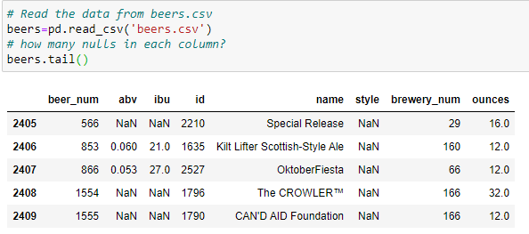
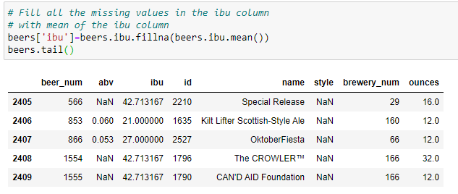
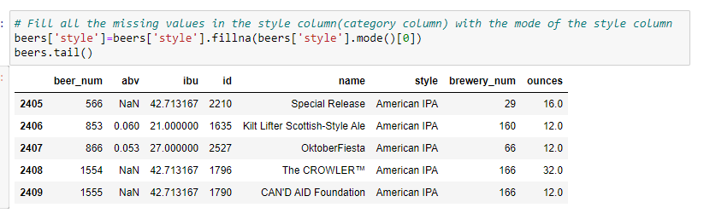
Filling in a missing value
Missing values can be dropped using the fillna() function
The fillna() function takes one value that we want to fill at the missing place
We can fill in using the mean, median, and mode

Slide 18
Handling Outliers
Outliers are those data points that are distant from most of the similar points
the outliers are entities that are different from the crowd
Outliers cause problems when it comes to building predictive models
long model training times
poor accuracy
an increase in error variance
a decrease in normality
a reduction in the power of statistical tests

Slide 19

Handling Outliers
There are two types of outliers: univariate and multivariate
Univariate outliers can be found in single variable distributions
Multivariates can be found in n-dimensional spaces
We can detect and handle outliers in the following ways:
Box Plot:
displays the outliers as individual points using the interquartile range.
Scatter Plot:
A scatter plot displays the points (or two variables) on the two-dimensional chart
Z-Score:
assumes a normal distribution of the data
The outlier lies in the tail of the normal curve distribution and is far from the mean

Slide 20

Handling Outliers
We can detect and handle outliers in the following ways:
Interquartile Range (IQR):
IQR is a robust statistical measure of data dispersion
It is the difference between the third and first quartile
These quartiles can be visualized in a box plot. This is also known as the midspread, the middle 50%, or H-spread
Percentile:
A percentile is a statistical measure that divides data into 100 groups of equal size
Its value indicates the percentage of the population below that value
For example, the 95th percentile means 95% of people fall under this category

Slide 21
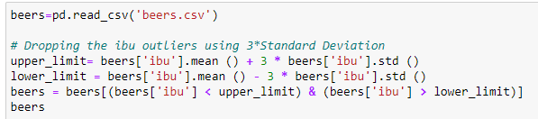
Removing Outliers
We can handle the outliers using standard deviation and the mean
We are using as the upper limit and as the lower limit for filtering the outliers

Slide 22
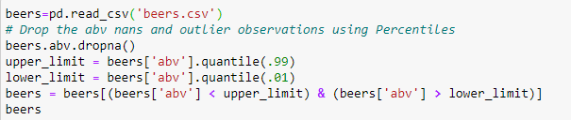
Removing Outliers
Here we remove the outliers by using a percentile of 1 for the lower limit and by using a percentile of 99 for the upper limit

Slide 23
Feature Encoding Techniques
Machine learning models are mathematical models that required numeric and integer values for computation
Such models can't work on categorical features
We often need to convert categorical features into numerical ones
Machine learning model performance is affected by what encoding technique we use
Categorical values range from 0 to N-1 categories

Slide 24
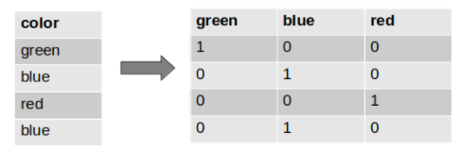
Feature Encoding Techniques One-hot encoding
One-hot encoding transforms the categorical column into labels and splits the column into multiple columns
The numbers are replaced by binary values such as 1s or 0s
For example in the colour variable, there are three categories, red, green, and blue
These three categories are labelled and encoded into binary columns

Slide 25
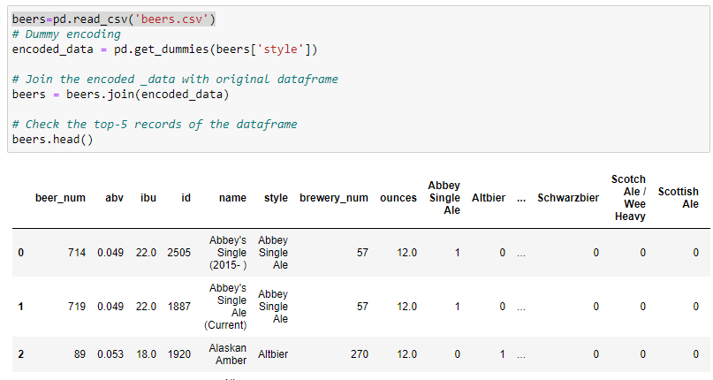
Feature Encoding Techniques One-hot encoding
One-hot encoding can also be performed using the pandas get_dummies() function

Slide 26
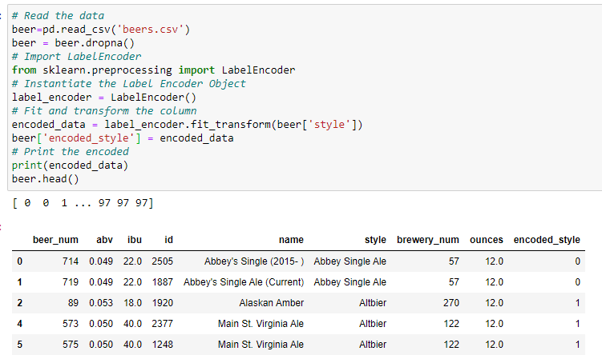
Feature Encoding Techniques Label encoding
Label encoding is also known as integer encoding
Integer encoding replaces categorical values with numeric values
Here, the unique values in variables are replaced with a sequence of integer values
For example, red, green, and blue
These three categories were encoded with integer values
red is 0, green is 1, and blue is 2

Slide 27
Feature Encoding Techniques Feature Scaling
In real life, most features have different ranges, magnitudes, and units
such as age being between 0-200 and salary being between 0 to thousands or millions
From a data analyst or data scientist's point of view, how can we compare these features when they are on different scales?
High-magnitude features will weigh more on machine learning models than lower magnitude features
Feature scaling (feature normalization) can solve such issues.
Feature scaling brings all the features to the same level of magnitude
This is not compulsory for all kinds of algorithms
some algorithms need scaled data - those that rely on Euclidean distance measures such as K-nearest neighbor and the K-means clustering algorithm

Slide 28

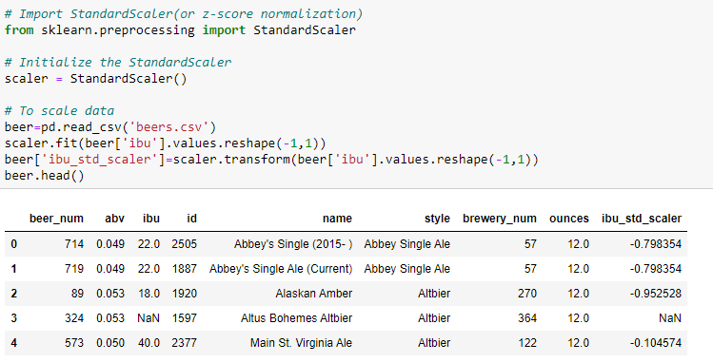
Feature Scaling Methods Z-Score Normalization (Standard Scaling)
This method computes the scaled values of a feature by using the mean and standard deviation of that feature
It is best suited for normally distributed data
We import and initialize the StandardScaler object
After initialization, we fit and transform the column that we want to scale

Slide 29

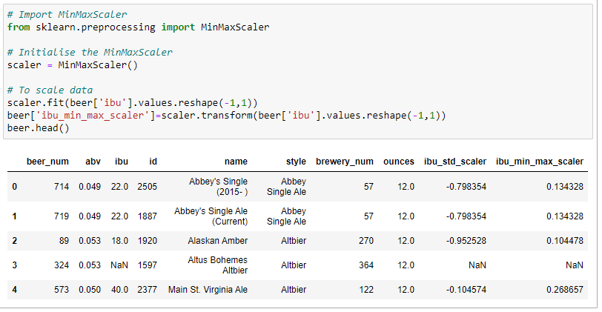
Feature Scaling Methods Min-Max Scaling
This method linearly transforms the original data into the given range
It preserves the relationships between the scaled data and the original data
If the distribution is not normally distributed the min-max scaler works better
It is more sensitive to outliers
We import and initialize the MinMaxScaler object
After initialization, we fit and transform the column that we want to scale

Slide 30
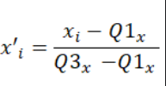
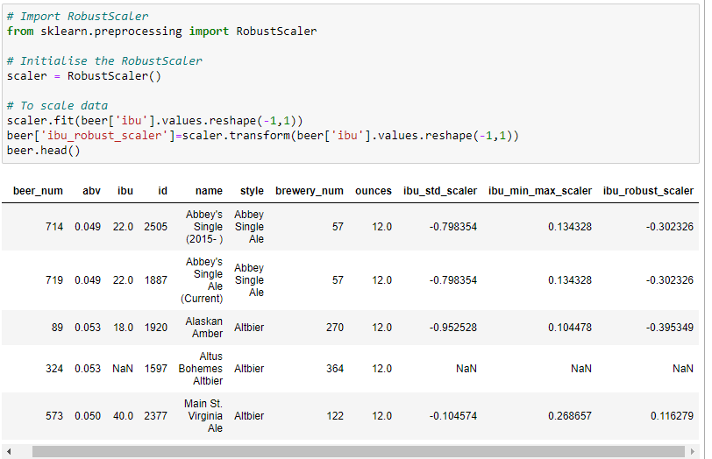
Feature Scaling Methods Robust Scaling
This method is similar to the min-max scaler method Instead we use the interquartile range
It is robust to outliers
We import and initialize the RobustScaler object
After initialization, we fit and transform the column that we want to scale

Slide 31
Feature Transformation
Feature transformation alters features so that they're in the required form
It can reduce the effect of outliers, handles skewed data, and makes the model more robust
Log transformation:
is the most common mathematical transformation used to transform skewed data into a normal distribution
ensure that all the data values ​​only contain positive values;
otherwise, this will throw an exception or error message
Square and cube transformation
has a moderate effect on distribution shape
It can be used to reduce left skewness
Square and cube root transformation
has a fairly strong transformation effect on the distribution shape
it is weaker than logarithms
It can be applied to right-skewed data

Slide 32
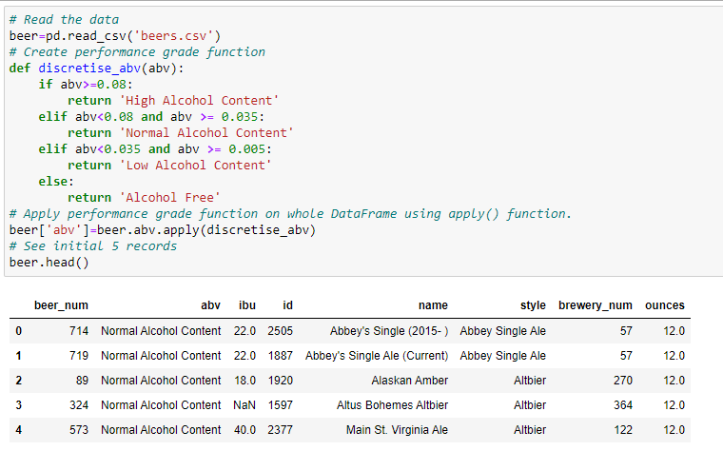
Feature Transformation
Discretization can also be used to transform a numeric column or attribute
For example, the age of a group of candidates can be grouped into intervals such as 0-10, 11-20, and so on
We can also use discretization to assign conceptual labels instead of intervals
such as youth, adult, and senior

Slide 33
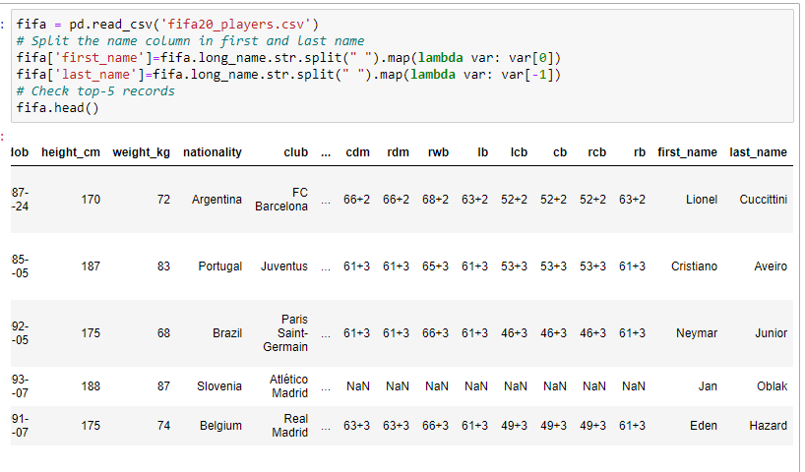
Feature Splitting
Feature splitting helps data analysts and data scientists create more new features for modelling
for example
splitting name features into first, middle, and last name
splitting an address into house number, locality, landmark, area, city, country, and zip code.
Feature splitting is a good option if you wish to generate more features from a composite feature
We can utilize the components of a column to do this
For example, from a date object, we can easily get the year, month, and weekday
These features may directly affect the prediction model
There is no rule of thumb when it comes to breaking the features into components; this depends on the characteristics of the feature

